Slide 1
Electronic Pre-Operative Anesthetic Plan (EPAP): Proof of Concept
Aalap C. Shah, MD
Clinical Fellow, Department of Anesthesiology, Perioperative & Pain Medicine
Boston Children’s Hospital

Slide 2
Introduction
BCH is a busy tertiary pediatric hospital with > 35,000 cases/year
~1-9 cases per OR per day
12 anesthesia technicians for 54 OR and NORA sites

Slide 3
Introduction
Shortcomings
Anesthesia plan disconnected from plan
EHR patient information → “scribbled” pen/paper anesthetic plans
Anesthetic plans often missing components, not well-connected to medical history, or disorganized
Does not communicate with end-users
Technicians
Pharmacists

Slide 4
Introduction
Consequences
Limited availability of high-demand equipment (especially for first-case starts)
Frequent wastage of unused / extraneous medications
Manual calculation of weight-based dosing is time-costly and error-prone

Slide 5
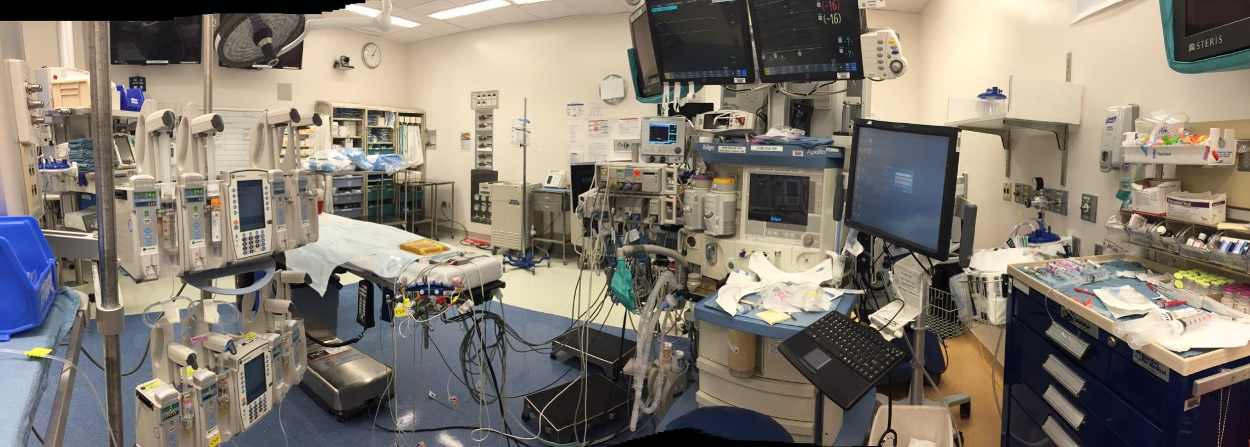

Slide 6
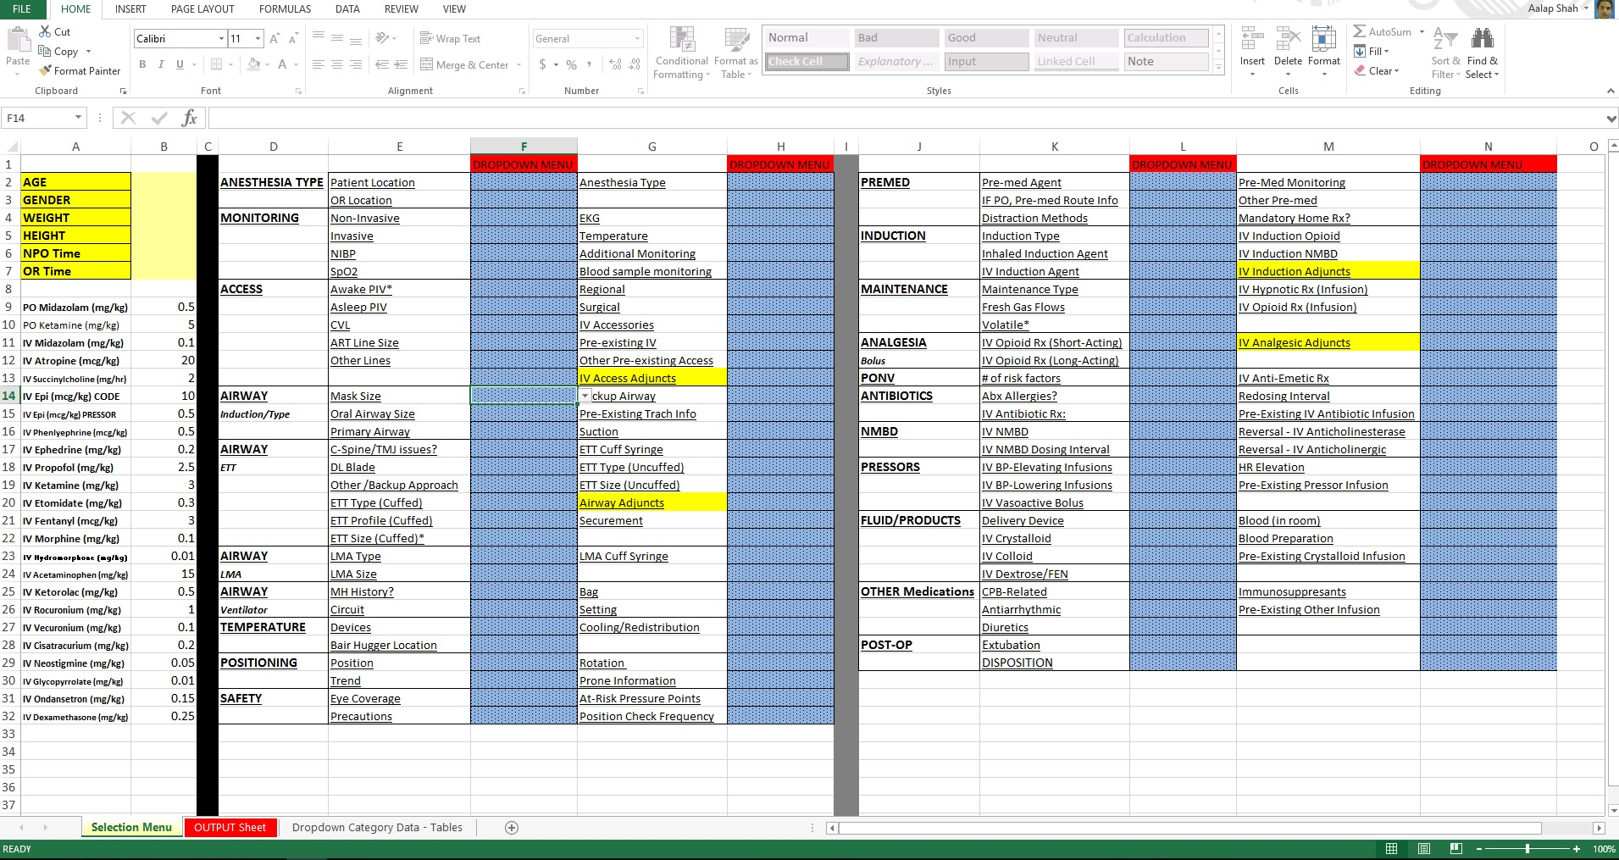
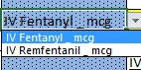
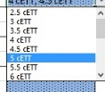
Proof of Concept - EPAP
I. Input Worksheet – “MENU”
September - October 2015
Demographics/ Dosing
OR Setup
Drug Choices

Slide 7
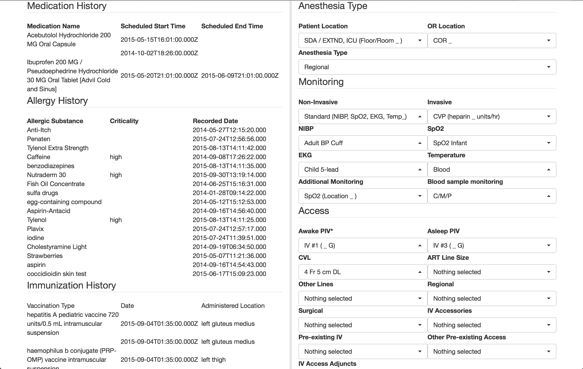
EPAP – Proof of Concept
INPUT

Slide 8
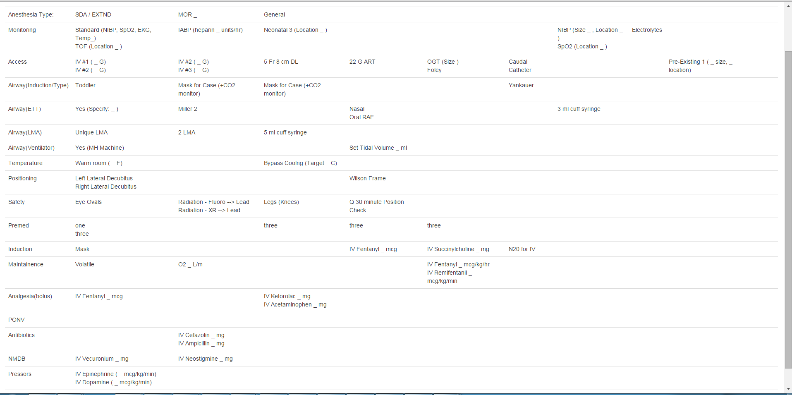
EPAP – Proof of Concept
OUTPUT

Slide 9
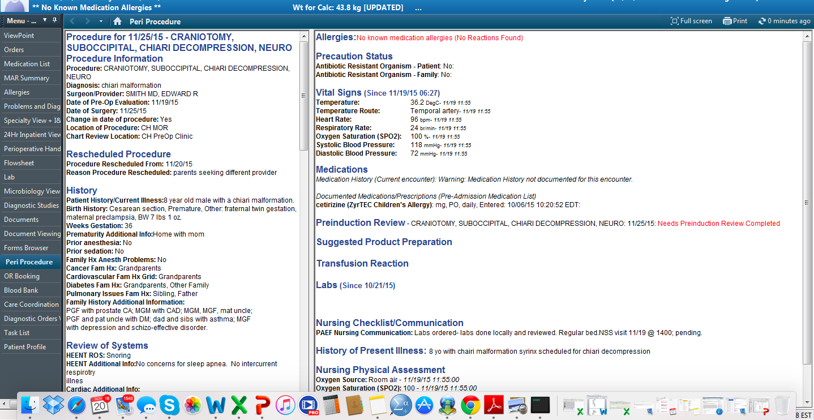

EPAP – Cerner Integration
SMART-On-FHIR Technology for EHR Integration
http://smarthealthit.org

Slide 10
EPAP - Workflow
Day before surgery:
3pm – case assignment
3-5pm – Complete INPUT sheet, vis a vis Pre-Anesthetic Evaluation
3-5PM – Submit sheet
Document in Cerner EHR
Transferred to Anesthesia Technician/Pharmacist “Grid”
6-10PM
Anesthesia Technician prioritizes equipment and sets up room;
Pharmacy creates list of time-sensitive Rx to be formulated

Slide 11
EPAP - Workflow
Day of Surgery:
Anesthetist pricks up medication box (with pre-filled syringes and drips) from pharmacy
Anesthesia workspace is set-up for case; last minute changes can still be communicated prior to case start
OR Pharmacists / Technicians use portable OR Dashboard to:
Communicate room ready and turnover status with central workroom
Match requests with available high-demand inventory (e.g. ultrasound, Glidescope)

Slide 12
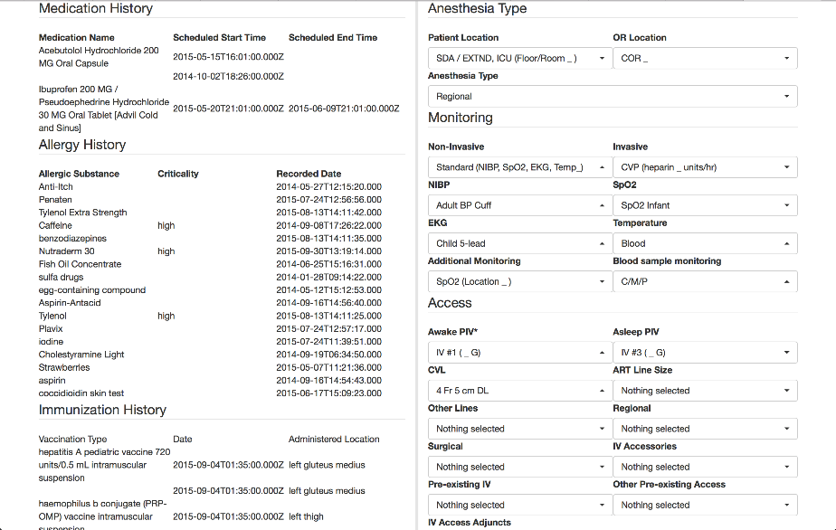
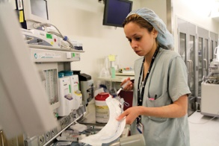

Electronic Pre-Operative Anesthetic Plan
OR Setup
Rx
OUTPUT Sheet
Technicians
Pharmacists

Slide 13
The Competition
No integrated pre-operative ordering systems at any academic medical centers
Several initiatives to standardize the POST-operative handover process.

Slide 14
Revenue / Costs
Buyers: Academic centers → private practice settings
Integrated system using SMART-on-FIHR technology
Anticipated Costs
Programming costs ($100k+ ) x time (>1000 hrs)
End-user workflow modifications
LCD screen for Tech Workroom and Pharmacy
Notification system for real-time case changes
Box?

Slide 15
Benefits
Combined disciplinary approach with closed-loop, synced communication with all end-users
Anesthesia providers, technicians, pharmacy
Connected patients and plans
Trainees have better grasp over each part of the plan as it relates to the patient’s surgery
EFFICIENCY
Decreased “scrambling” of technicians on the AM of surgery
Decreased medication wastage ($$$)
Medication dosage checks/balances

Slide 16

Hacking Pediatrics Mashup 2015
BCH – Michael Docktor, MD
Saturday, November 14, 2015, 8am-8pm
Worked with Cerner representatives to program EPAP demo
Delivered project pitch in front of VCs, software company/engineers, clinicians
Winner: “Greatest Institutional Impact”

Slide 17
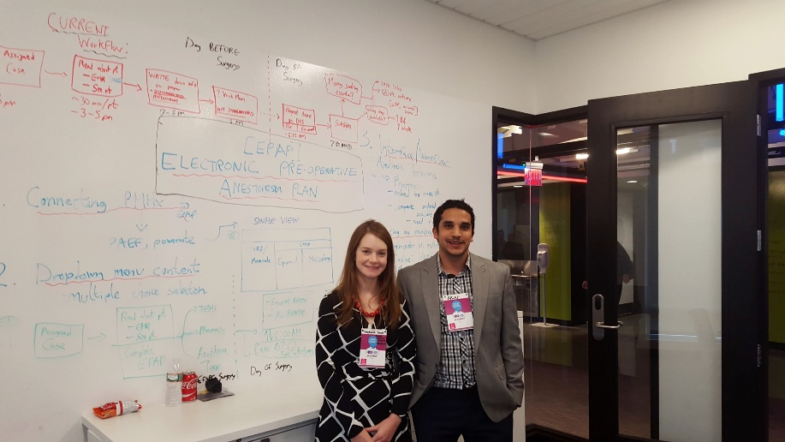
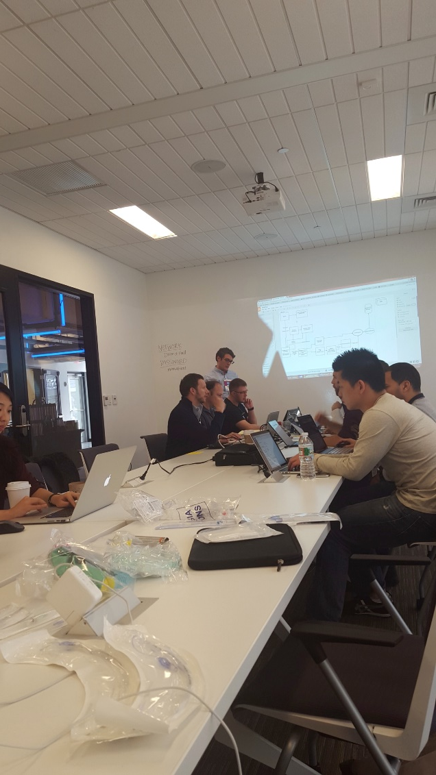
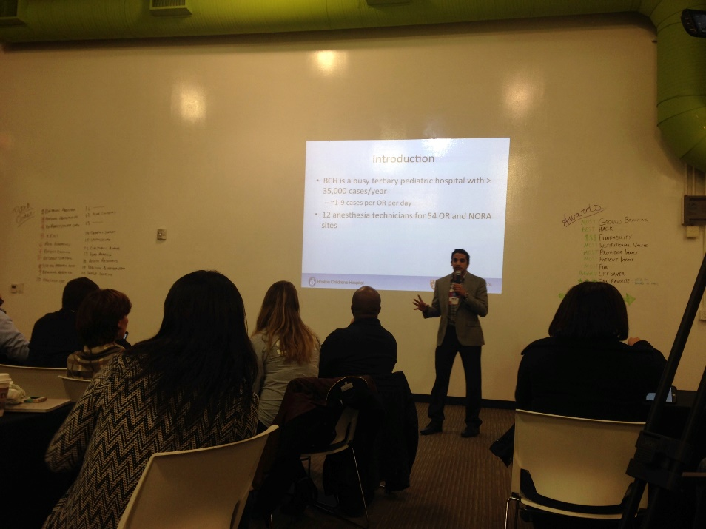
Hacking Pediatrics Mashup 2015
November 2015

Slide 18
Timeline
I. EPAP Proof of Concept August-November 2015
Hacking Pediatrics / Cerner Meeting November 14, 2015
II. Cost-Containment/Effectiveness December – February 2015 Analyses
Meeting with Dr. Ferrari (Cerner Liaison) December 11, 2015
BCH Innovations Team meeting December 17, 2015
TIDO
II. Feedback / Improvements December-February 2016
III. Software Programming February-August 2016
IV. Anesthesia Technician / February-August 2016
Pharmacy workflows
V. Single-Center Implementation Analysis August 2016-July 2017
VI. Final Product Development late 2017

Slide 19
Cost Containment / Effect Size
Assess leftover medication and supply waste
Random sample of OR visits post-procedure to quantify waste, x 1 week
Estimate cost associated with each wastage product
Pre- / Post-Implementation
Single Center RCT
Measure End-User Satisfaction
Balance Measures:
Patient Preparation Time
Medication / Equipment Preparation and Allocation

Slide 20
Feedback / Improvements
Incorporation with technician/pharmacy workflow (“OR Dashboard”)
Touch-screen Grid system, arranged by OR, swipe for consecutive cases
Real-time notification system for changes (Box?)
Weight-based calculations
e.g. , medications, fluid management

Slide 21
Feedback / Improvements
Embedded reference chart and decision-making algorithms
Case- or Specialty-Specific Ordersets or “PowerPlans”
e.g. craniosynostosis, tonsillectomies, solid organ transplants, cardiac bypass cases, etc.
Individual items can be modified (similar to our Cerner EHR Powerchart Ordersets)

Slide 22
Thank you!
Development Team
Clinical:
Aalap Shah, MD: Clinical Fellow in Anesthesia
Carlos Munoz, MD: Senior Associate in Anesthesia
Skip Kitchen: Lead Anesthesia Technician
System Engineer / Software Developer
Juan Garcia
Roshan Mahareddy
Sam Lambson, Director of Open Development
Consultants
Stephanie Grant, MD: Fellow in Cardiac Anesthesia
Sandra Lee: Anesthesia Technician

